Slide 1
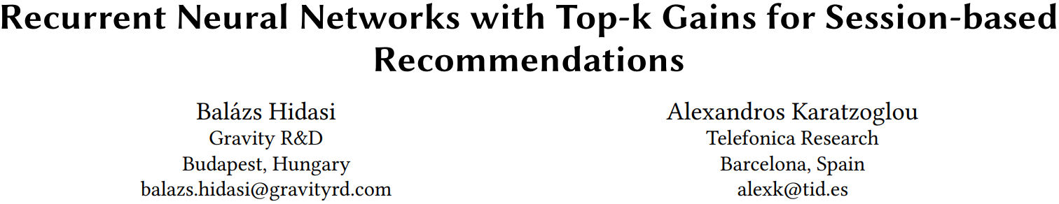

Slide 2
Introduction
The exact ranking or scoring of items in the tail of the item list (items that the user will not like) is not that important, but it is very important to rank correctly the items that the user will like at the top of the list (first 5, 10 or 20 positions). To achieve this with machine learning, one has to typically utilize learning to rank techniques and in particular ranking objectives and loss functions.
Pairwise loss and listwise loss are typical loss functions of learning to rank. These loss functions work well in matrix factorization dose not guarantee in any way that they are optimal choice for RNNs as backpropagation requirements are stronger than those posed by simple SGD.

Slide 3
Sampling
Sampling is essential and crucial for learning to rank task.
When utilizing a sampling procedure, it is important that high scoring items are included among the negative samples to update gradients effectively.
Popularity-based sampling is a good sampling strategy, since popular items generally score high in many situations.
Mini-batch sampling is basically a form of popularity-based sampling, since the training iterates through all events, thus the probability of an item acting as a negative sample is proportional to its support.
Since popularity-based sampling will focus more on popular ones, learning can slow down and can still be inaccurate for ranking long tail high scoring items.

Slide 4
Sampling
Utilizing the parallelization capabilities of current hardware better, thus training faster, and producing more stable gradients than stochastic gradient training and thus converging faster.
Mini-batch sizes are generally small, ranging from few tens to few hundreds. If the number of items is large, the small sample size further hinders the chance of including all of the high scoring negative examples.
There is a trade-off between accuracy and parallelization. Small mini-batch size (30-100) produces more accurate models, but training with larger ones is faster on the GPU due to parallelization.

Slide 5



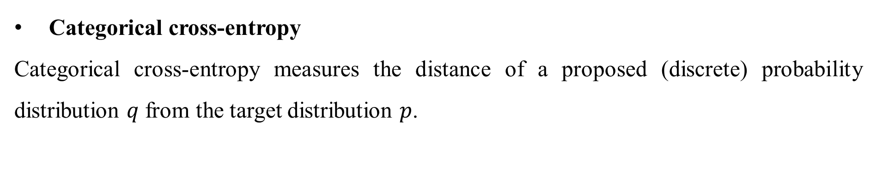
Loss Function
Categorical cross-entropy
Categorical cross-entropy measures the distance of a proposed (discrete) probability distribution $q$ from the target distribution $p$.
It is common practice to use the softmax to transform the output scores as a form a distribution.

Slide 6
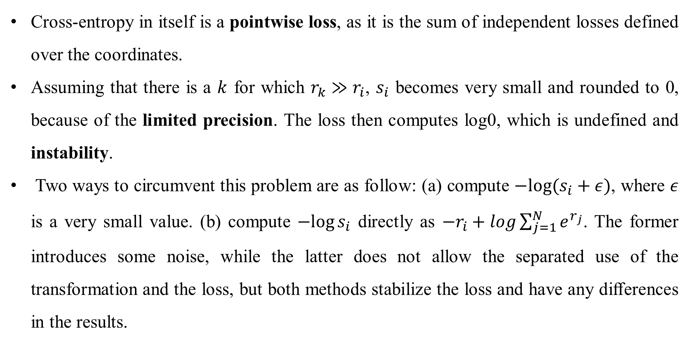
Loss Function
Cross-entropy in itself is a pointwise loss, as it is the sum of independent losses defined over the coordinates.
Assuming that there is a $k$ for which $r_{k}≫r_{i}$, $s_{i}$ becomes very small and rounded to 0, because of the limited precision. The loss then computes log0, which is undefined and instability.
Two ways to circumvent this problem are as follow: (a) compute $−log⁡(s_{i}+ε)$, where $ε$ is a very small value. (b) compute $−log⁡s_{i}$ directly as $−r_{i}+log\sum_{j=1}^{N}{e^{r_{j}}}$. The former introduces some noise, while the latter does not allow the separated use of the transformation and the loss, but both methods stabilize the loss and have any diﬀerences in the results.

Slide 7

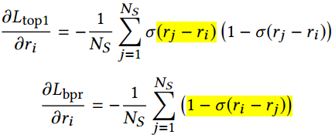

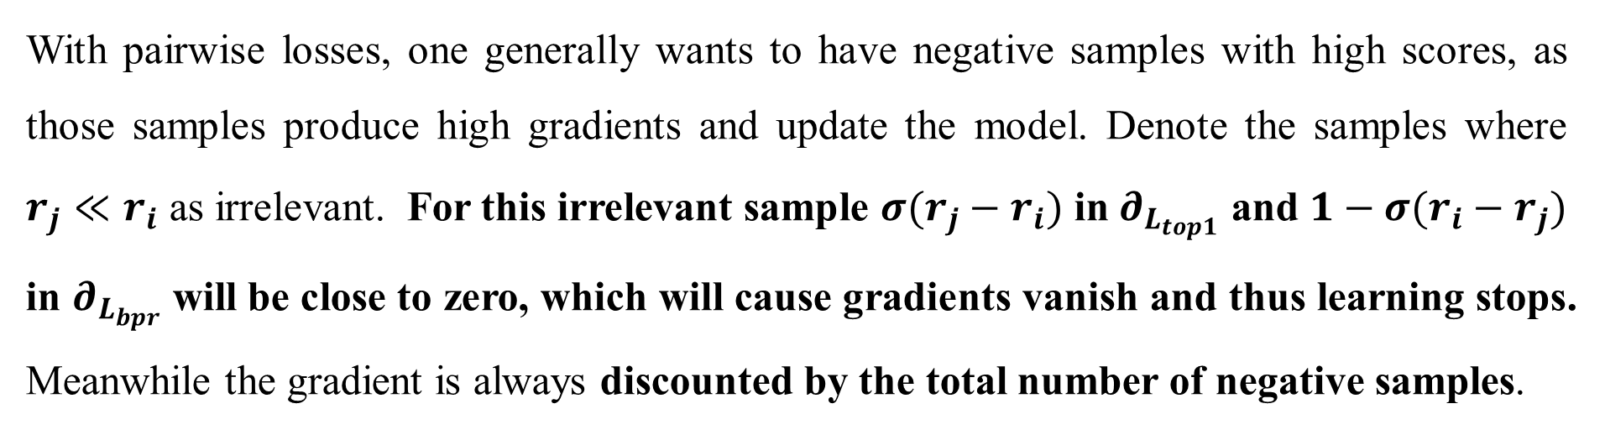
Loss Function
Ranking losses: TOP1 & BPR
With pairwise losses, one generally wants to have negative samples with high scores, as those samples produce high gradients and update the model. Denote the samples where $r_{j}≪r_{i}$ as irrelevant. For this irrelevant sample $σ(r_{j}−r_{i})$ in $∂_{L_{top1}}$ and $1−σ(r_{i}−r_{j})$ in $∂_{L_{bpr}}$ will be close to zero, which will cause gradients vanish and thus learning stops.
Meanwhile the gradient is always discounted by the total number of negative samples.

Slide 8

Loss Function
Ranking-max loss function family
The idea is to have the target score compared with the most relevant sample score, which is the maximal score amongst the samples.
The maximum selection is non-diﬀerentiable and thus cannot be used with gradient descent. Therefore we use the softmax scores to preserve diﬀerentiability.

Slide 9




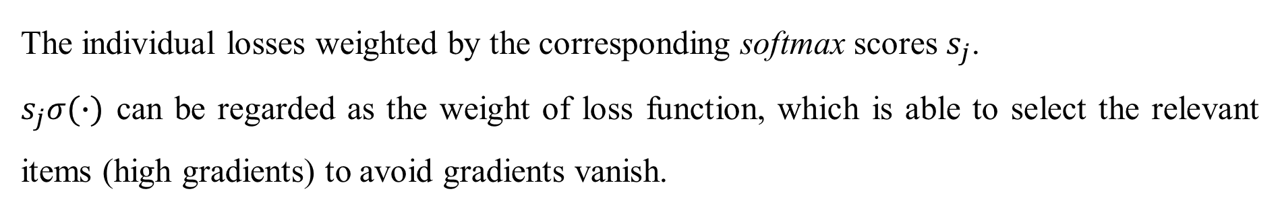
Loss Function
TOP1-max & BPR-max
The individual losses weighted by the corresponding softmax scores $s_{j}$.
$s_{j}σ(∙)$ can be regarded as the weight of loss function, which is able to select the relevant items (high gradients) to avoid gradients vanish.

Slide 10

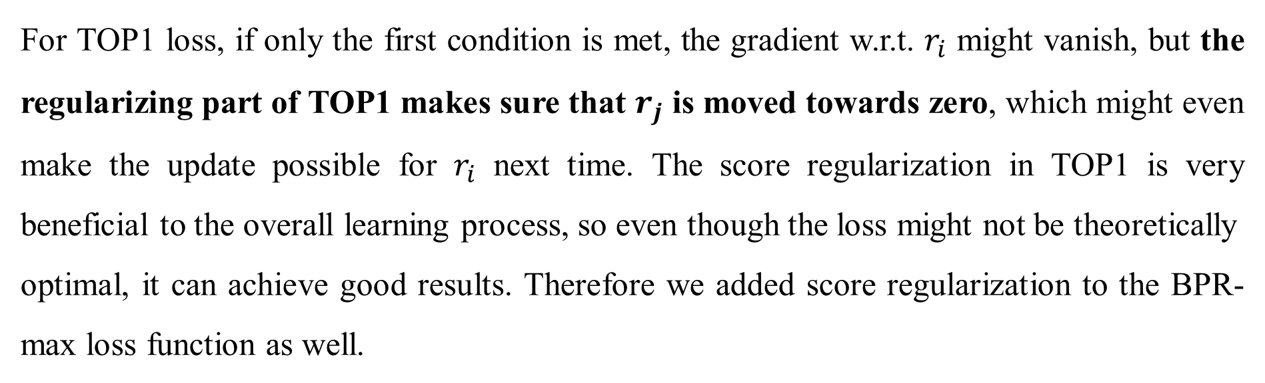
Loss Function
BPR-max with score regularization
For TOP1 loss, if only the first condition is met, the gradient w.r.t. $r_{i}$ might vanish, but the regularizing part of TOP1 makes sure that $r_{j}$ is moved towards zero, which might even make the update possible for $r_{i}$ next time. The score regularization in TOP1 is very beneficial to the overall learning process, so even though the loss might not be theoretically
optimal, it can achieve good results. Therefore we added score regularization to the BPR-max loss function as well.

Slide 11
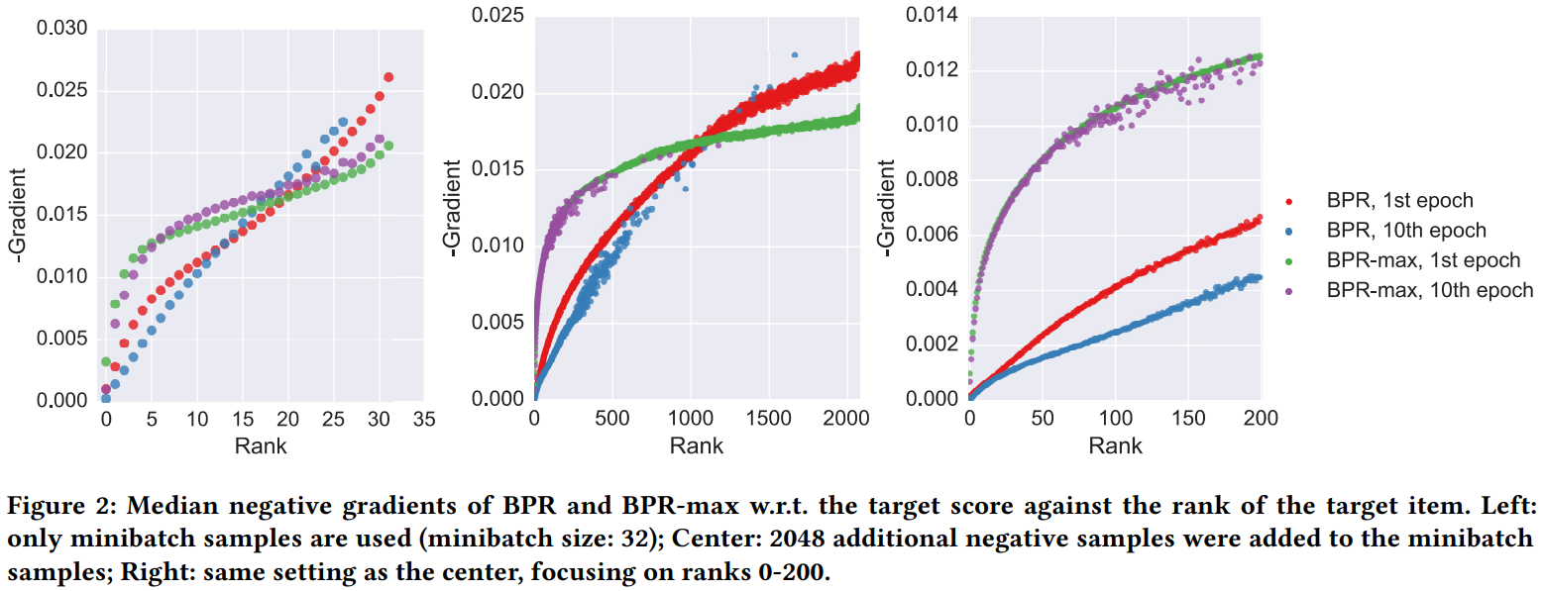
Experiments

Slide 12
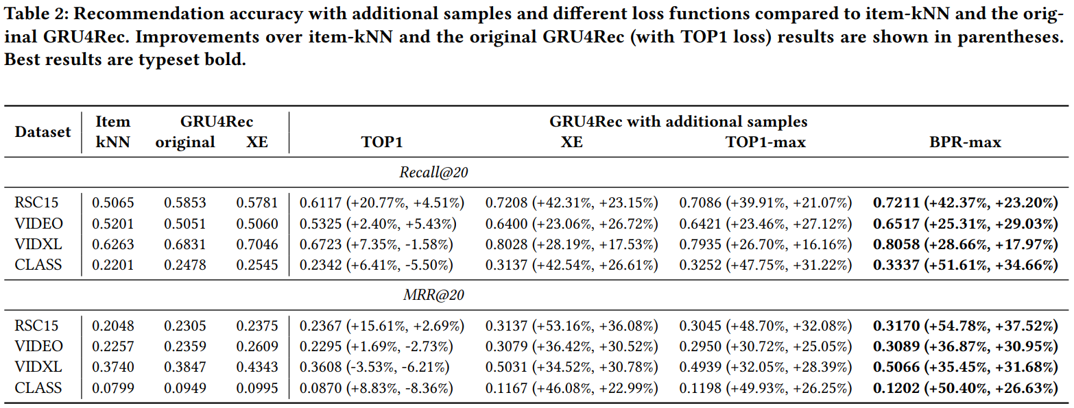
Experiments

Slide 13
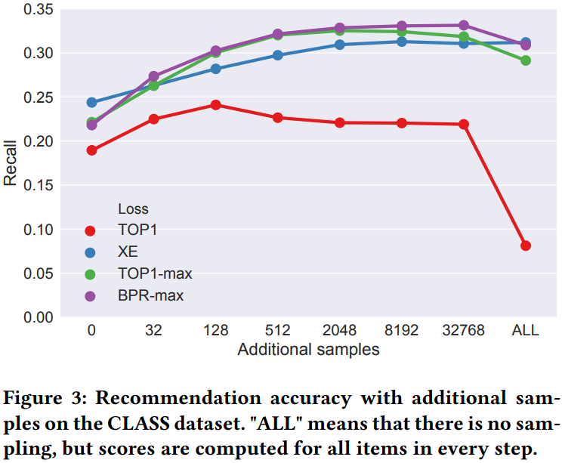
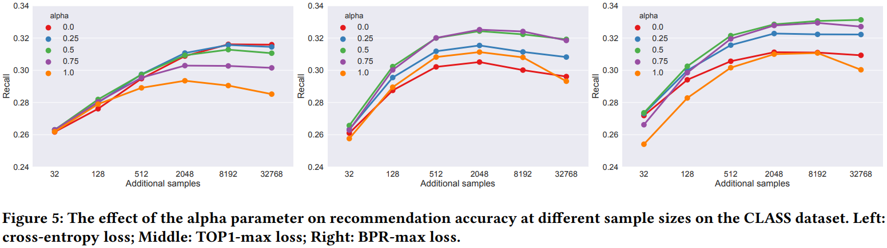
Experiments

